Slide 1
CS410/510 Cloud & Cluster
Project part 3
Greenbay Project Team

Slide 2

System Summary:
System Name: CouchDB
Data Model: Document Model
Key Use Cases:
Relaxed/Eventual Consistency,
Web Content,
Logging (Readings, live sports data and events)
Data that doesn't change but high volume

Slide 3
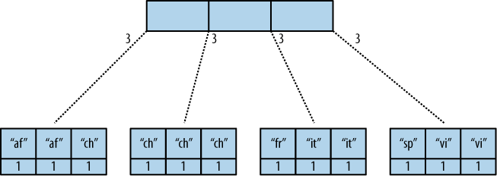
Key Architectural Decisions
B -Tree Based
Self Balances
logarithmic performance (insertions,searches, and deletions) and self balances
Incremental replication between clusters with automatic conflict resolution

Slide 4

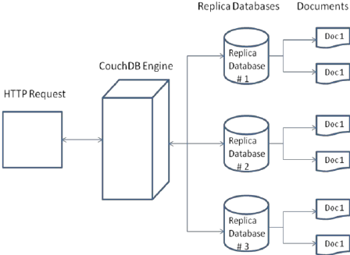
Query Model
Json query syntax -> sends to api endpoint using an http request as a POST command
Body must contain selector field to select some documents.
API allows skipping first n results or limit the number of results returned.
Supports paging for bookmarks.

Slide 5
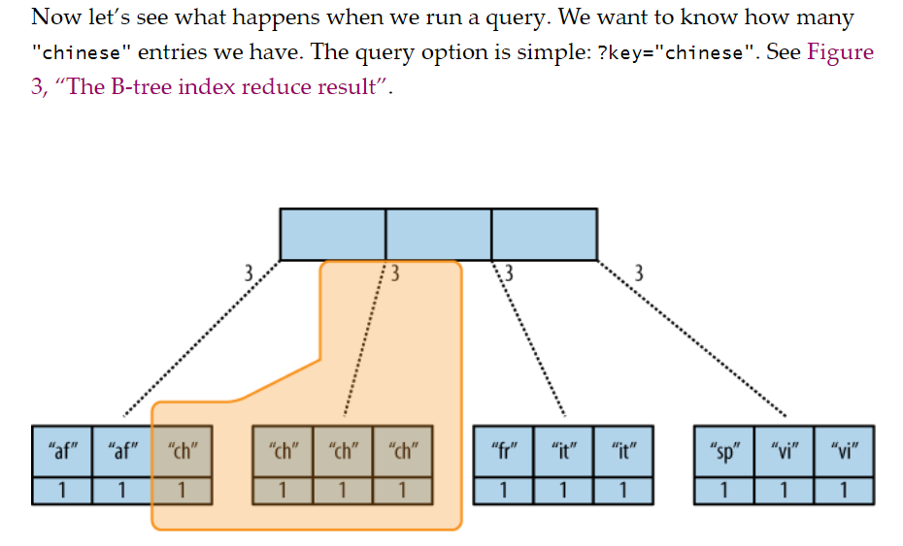
Indices
The stored data is structured using views.
In CouchDB, each view is constructed by a JavaScript function that acts as the Map half of a map/reduce operation.
The function takes a document and transforms it into a single value that it returns.
CouchDB can index views and keep those indexes updated as documents are added, removed, or updated.
Suggested Indices:
_id → “name”
_id → “relationships*”
Further reading: http://guide.couchdb.org/draft/views.html

Slide 6
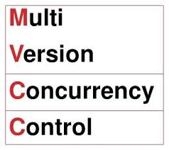
Transactions and Concurrency Control
Multi-Version Concurrency Control that allows concurrent reading of data.
If we didn't have a current control method, then we could see incomplete writes of data or data that is not consistent.
When An MVCC system like CouchDB must work on some data that is stored, the previous version of the data is retained, and a new version is created.
We do not deal with locks like relational databases use, but this is typical for NoSQL distributed systems. Gives us an advantage to use more resources during larger loads on the database and allows it to run very fast.

Slide 7

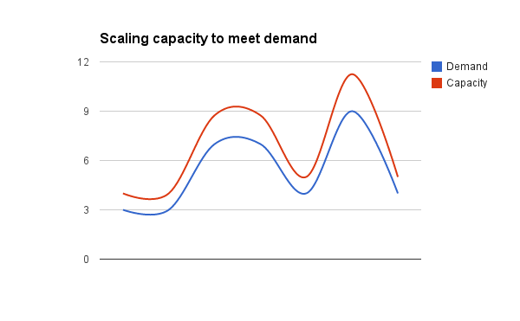
Scalability and Replication
System supports replication
both database replication and shard replication
Automatic replication is configured automatically as a system preference
Database replication can be achieved through the schedulering replicator.

Slide 8
Data
Our approach uses only two distinct document structures
Publication
Type
Data
Person
Double Connections
Publications point to Persons and Persons will point to Publications.
The simplified structure allows for simplified query algorithms.
However it will require additional maintenance on insertion and updates.

Slide 9
Data
Publication:
‘_id’ = unique string
Type: string
Authors: string array
Editors: string array
Person:
‘_id’ = unique integer
Name: string
Type: string = “person”
Works written: string array
Works Edited: string array
Data (Varies depending on type)
Citations*: Integer Array
Works Cited By: Integer Array
Papers included*: String Array
year, title, url (if type == www)
volume, year, title, conference, publisher, isbn, series (if type == proceedings)
volume, year, title, publisher, isbn, series, collection_papers (if type == book)
title, publisher (if type == journal)
Title, in_collection, in_journal, in_proceedings (if type == paper)
year, title, publisher, isbn, series, school (if type == phdthesis)
year, title, school (if type == msthesis)

Slide 10
Data: Examples in DB JSON
Example for Document Object
{
_id: “12002”
“Type”: “journal”
“Works Cited By”: [“12003”, “12004”]
title : “The Title Data”
“publisher” : “The Publisher Data (NOT PERSON)”
“Papers contained”: “12005”
}
Example for Person Object
{
_id: ‘15500’
“Type”: “person”
“Works Written”: [“12003”]
“Works Edited”: “The Title Data”
}

Slide 11
Process to restructure data
The dblp data was in organized into three main groups: ObjectID, Links, and Attributes associated with both of the former. Scattered across a massive XML file.
“People” and “Paper” object types and where papers were published made up a bulk of the data’s attributes and relations.
An XML to JSON convertor was written in Python to transform the dataset into JSON that could be uploaded to CouchDB in bulk.

Slide 12
Process to restructure data
The ObjectID group was redundant, the attributes for each object type had the Object’s unique ID listed with it.
Object types and attributes were simply converted to native Python data structures (dictionaries and lists)
Several Object and Link types:
Object Types: Person, Paper, Journal, Proceeding, Book, www, Phdthesis, Msthesis
Link Types: in-proceedings, author-of, in-journal, cites, editor-of, in-collection

Slide 13
Dealing with links
Created three dictionaries for each link to act as temporary “indices”.
Link structure, ID: ObjectID1 -> ObjectID2
“ID”, “ObjectID1”, “ObjectID2” each used as keys for dictionaries with lists of objects.
Example: ObjectID2: [ (ID_1, ObjectID1_1), (ID_2, ObjectID_2), …., (ID_N, ObjectID_N) ]
Could find forward (Person->Papers(s)) and reverse relations (Paper -> Person(s))
A JSON library made it easy encode all the Python data structures to JSON, making it very easy to upload in bulk to CouchDB.

Slide 14
Obj Type: Person example… in Nasty XML
728518 <OBJECT ID="728514"/> #redundant!
...many lines later…
1200123 <LINK ID="2157185" O1-ID="728514" O2-ID="642145"/>
...many more lines later…
5865755 <ATTR-VALUE ITEM-ID="728514">
5865756 <COL-VALUE>person</COL-VALUE>
5865757 </ATTR-VALUE>
...many many more lines later…
8145749 <ATTR-VALUE ITEM-ID="728514">
8145750 <COL-VALUE>Tolga Yurek</COL-VALUE>
8145751 </ATTR-VALUE>

Slide 15

Obj Type: Person example… in Nasty XML
...still going…
11023857 <ATTR-VALUE ITEM-ID="2157185">
11023858 <COL-VALUE>author-of</COL-VALUE>
11023859 </ATTR-VALUE>
...are we done yet?
5606648 <ATTR-VALUE ITEM-ID="642145">
5606649 <COL-VALUE>paper</COL-VALUE>
5606650 </ATTR-VALUE>

Slide 16

Obj Type: Person example… in Glorious JSON
29 {
30 "_id": "728514",
31 "Name": "Tolga Yurek",
32 "Type": "person",
33 "Works Written": [
34 "642145"
35 ],
36 "Works Edited": []
37 },

Slide 17
Restructuring challenges and observations
While the dataset on disc was 991MB of XML, the Python XML library chewed up 9GB of RAM after fully parsing.
Uploading one large JSON file to CouchDB takes a long time and was prone to “unknown errors”.
Solution: break files into smaller chunks to better indicate which ones succeed vs. failed.
CouchDB won’t allow you to add a document with “id” that already exists. Can simply re-submit a JSON file that had an error and will not result in duplicates.

Slide 18
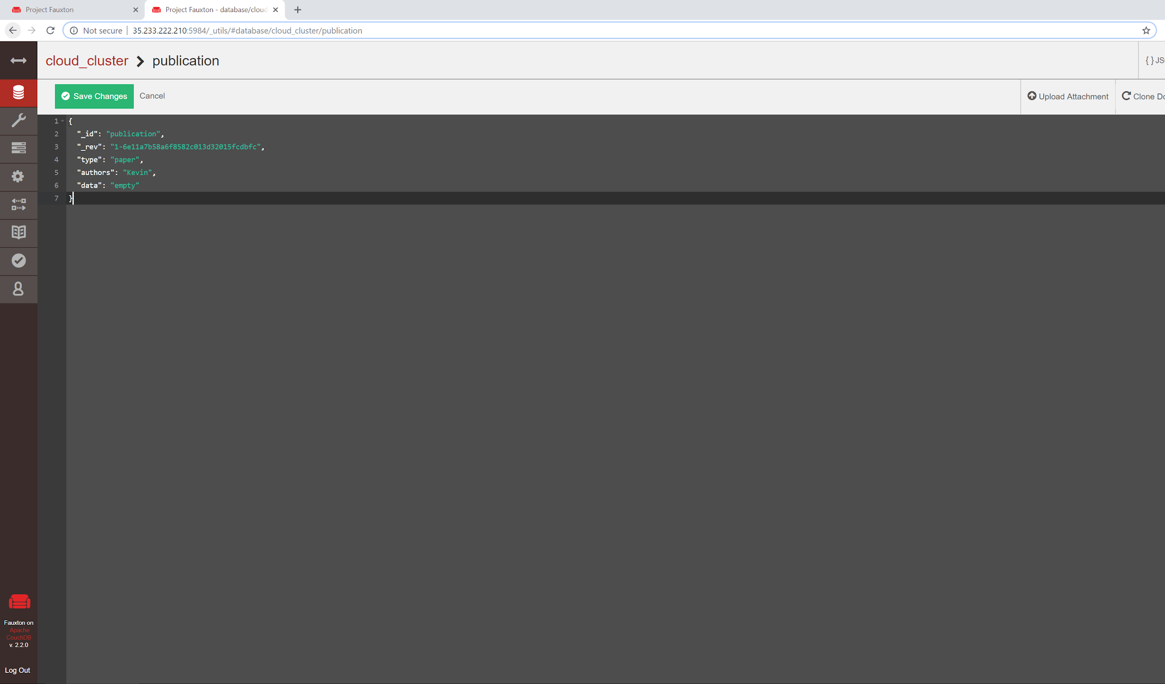
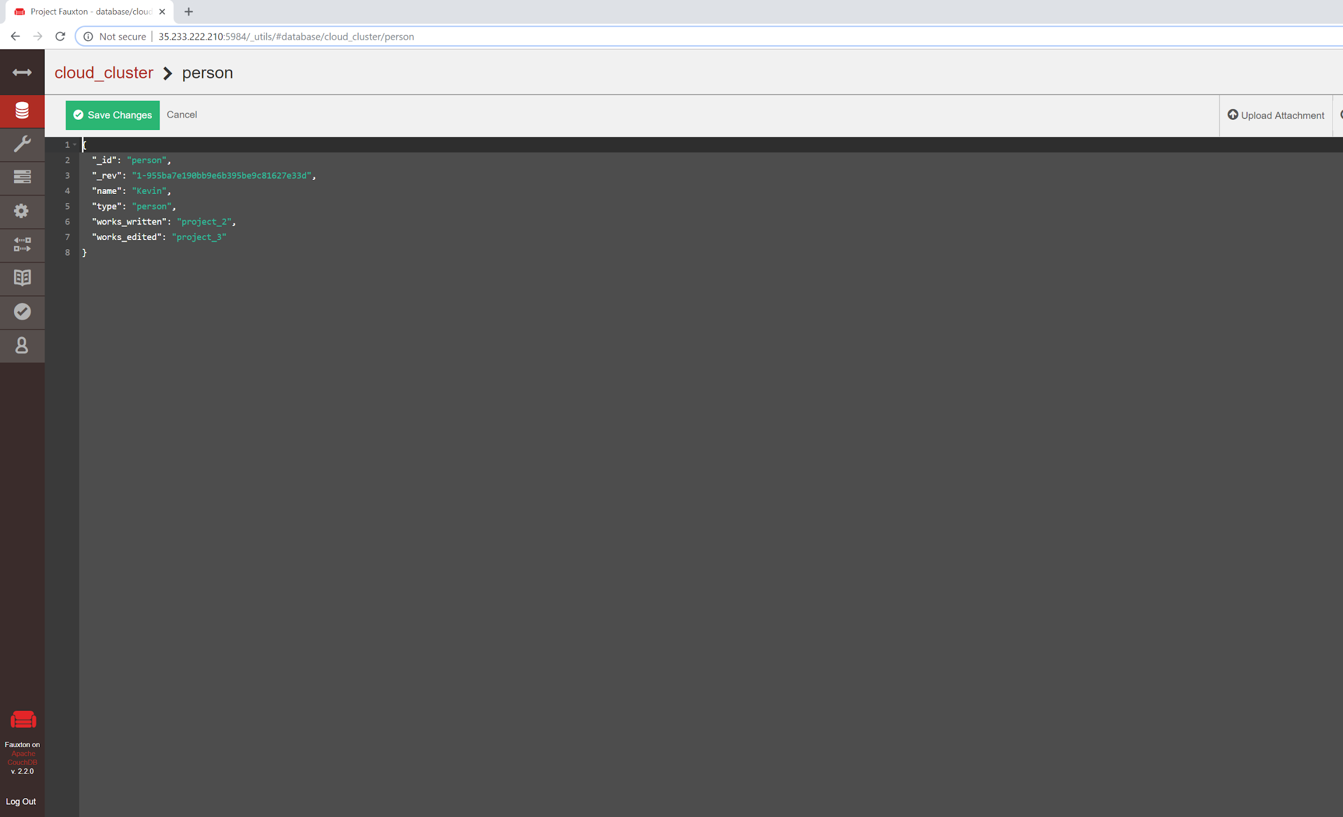
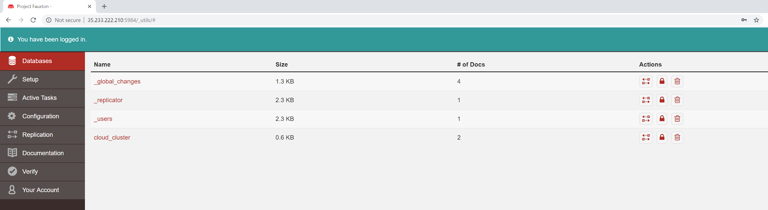
Proof we have loaded some data

Slide 19
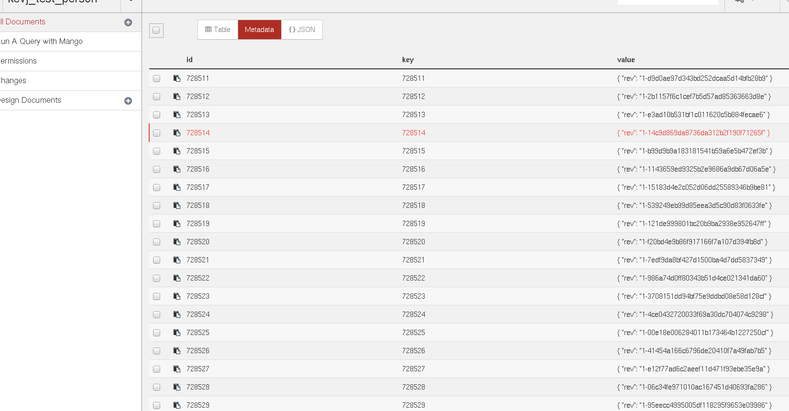
Proof we have loaded some data

Slide 20
Query 1: Co-Author Count
Implementation strategy:
This algorithm loops over every publication object.
For each object, we count the unique author ids that this publication contains.
We keep the key of the publication with the largest coauthor count.
Pseudo Code: LargestAuthor = NULL LargestAuthorCount = -1 for each Pub.key in Publication DataStructure localAuthorCount for each A in Pub.Authors localAuthorCount += 1 If localAuthorCount > LargestAuthorCount LargestAuthor = Pub.key return get(LargestAuthor)

Slide 21
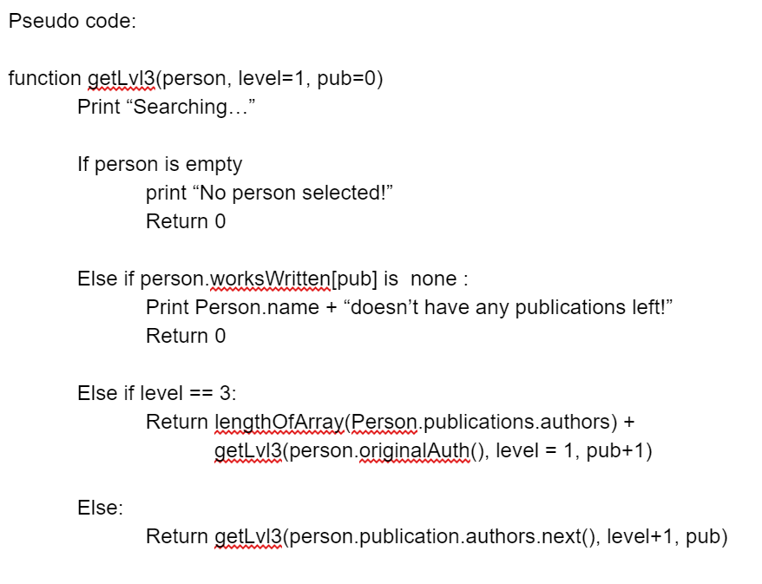
Query 2 : Recursive co-author
To implement a recursive query of level 3 co-authors we will have to create a user defined function. As we’ll be searching the people database and referencing the publications dataset.

Slide 22
Query 3: Co-author distance
Implementation strategy: Due to the way our data is structured in our document model, we can not implement this query directly. We will have to recursively make smaller queries and evaluate their result until we get what we need.
Pseudo Code:
Input: x and y = authors you wish to check co-author distance between.
For work in x.works_written:
If y in work.authors:
Return 0
Recursive function(x, z, level, y) where x = a co-author of x with a distance of ‘level’
Check if y is a co_author on any of z’s works
If so, return level + 1
Else call the function again with level + 1 and on each of z’s co-authors who aren’t x.

Slide 23
Query 4: (Year) Proceeding with most authors
Implementation strategy: This is looking for which proceeding in 2010 had the most distinct slides. We will query on the type: proceeding and year value 2010. Since we are storing the paper id’s in the proceedings we can simply loop over the keys for each paper and then add each distinct author listed in those papers.
Pseudo Code:
LargestProceeding = NULL
LargestProceedingACount = -1
For each Pub.key in the Publication data structure:
Set AuthorCount to zero
Set AuthorList to empty
If Pub.count == ‘proceeding’ && Pub.year == 2010
For each Pap.key in Pub.papers_included
Author.addeach(Pap.author)
AuthorCount = AuthorList.size
If AuthorCount > LargestProceedingACount
LargestProceeding = Pub.key
Return LargestProceeding

Slide 24
Query 5: Triangles
Implementation strategy: We can leverage map_reduce to determine which author’s even qualify for a “triangle”. Which would only be those who have written more than paper. In a similar fashion, we can do the same with the authors listed in paper. Any paper with less than two authors won’t be considered. This query won’t benefit from any additional indicies.
Pseudo Code:
Auth = Map_reduce (Key: Authors, Values: Works Written)
Papers = map_reduce ( Key: Papers, Values: authors)
for each author in Auth:
author's works written count < 2
remove from Auth
else
query papers written and store
for each paper in Papers:
paper's authors < 2
remove from Papers

Slide 25
Query 5: Triangles continued...
for each author’s (papers written) in Auth: if author.papers in Papers query paper's authors remove current author under test
and remove paper’s authors who are not in the Auth set store remaining paper’s author pairs in a candidate set CS (key: paper, key: author) for each C in CS: remove C from CS for each E in remaining CS
if C.paper is not equal E.paper and if C.author is not equal to E.author query works written for C.author and store in a set query works written for E.author and store in a set Find the intersection of each set, if set is not empty add a triangle to the count for the Author under test
loop over author triangle counts
return author with the highest count

Slide 26
Query 6: Connectivity
Visited = NULL
Visiting = NULL
Current = first key from Person Data Structure
do
{
ToAdd = empty vector
If current.type == ‘person’
ToAdd.add(current.works_written)
ToAdd.add(current.works_edited)
If current.type == ‘proceeding’
ToAdd.add(current.papers_included)
If current.type == ‘journal’
ToAdd.add(current.papers_contained)
If current.type == ‘book’
ToAdd.add(current.collection_papers)
If PUBLICATION_TYPES.in(current.type)
ToAdd.add(current.authors)
ToAdd.add(current.editors)
ToAdd.add(current.citations)
ToAdd.add(current.works_cited_by)
For each object in ToAdd
If NOT (visited.isIn(object.key ) OR visiting.isIn(object.key))
visiting.add(object.key)
visiting.remove(current.key);
visited.add(current.key);
Current = visiting.next();
} While visiting != NULL
For each item in Publishing or Person data structure
If NOT visited.isIn(item.key)
return false
return true;
Users/
Publications
get next connected
get_connected results()
Current
Is result in visiting or visited?
add current to visited
get next visiting
If no, add to visiting
If yes, add to visited
Visiting
Visited

Slide 27
Update capabilities
Our Data design requires double updates.
Our data structure requires that changes to relationships update both objects.
Potentially, this will add to update cost and the overall size of the DB
However this provides significant speed to graph traversal
Use of Design Documents will facilitate updates and insertions.
Javascript files inserted at a table level.
Allows for the automation of relationship insertion. Such as:
Insert Relationship
Remove Relationship
Insert Document
Remove Document

Slide 28
System Summary
System Name | Data Model | Key Use Cases | Key Architectural Decisions | Query Model | Indices | Xacts & CC | Scalability & Replication
Couch DB | Document | Document Storage | Double relationship dependency, single pro | Map-Reduce, String Parsing | index views | Multi-Version Concurrency Control, no transaction support | System Handled Sharding &

Slide 29
Questions?
Demo: http://35.233.222.210:5984/_utils/#login

